Slide 1



For the purpose of Forage virtual experience program
BRITISH
AIRWAYS
PREDICTIVE MODEL RESULTS
DATE
January 14, 2024

Slide 2
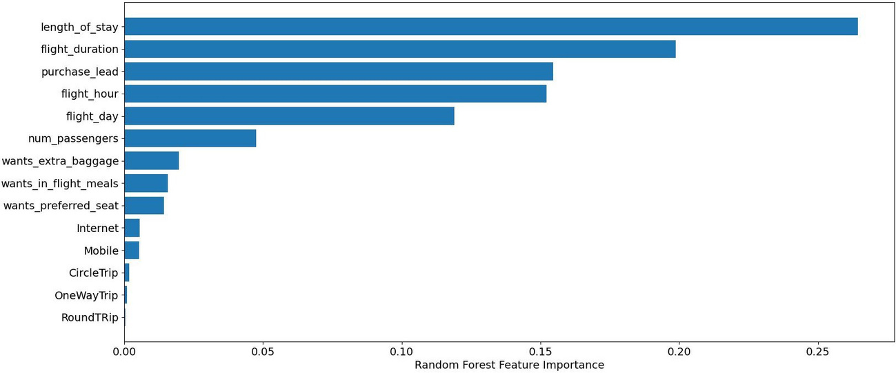
Predictive Model Results
Imbalanced dataset was rectified by smote method by creating a total of 85012 data points
.90
F1-SCORE
Imbalanced dataset may provide higher accuracy but is not beneficial for practical usecases
94%
Actually completed bookings out of all predicted bookings
PRECISION
90%
Accuracy of the model predicting successful booking is
ACCURACY

